Slide 1
7 March 2021

Slide 2
Memory Verse
The Lord is my Shepherd
- Psalm 23:1A-

Slide 3
Alkitab
Alkitab penuh c’rita Tuhan
C’rita indah, c’rita indah
Alkitab penuh c’rita Tuhan
Aku mau mendengarkan

Slide 4
Bible Story Time!

Slide 5
SIN ?? DOSA??
Notes:
Sin is when we do things our way instead of God's way
sin is the bad stuff we do that makes God sad and separates us from Him

Slide 6
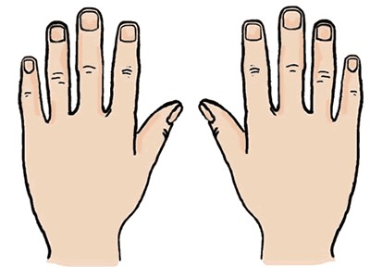
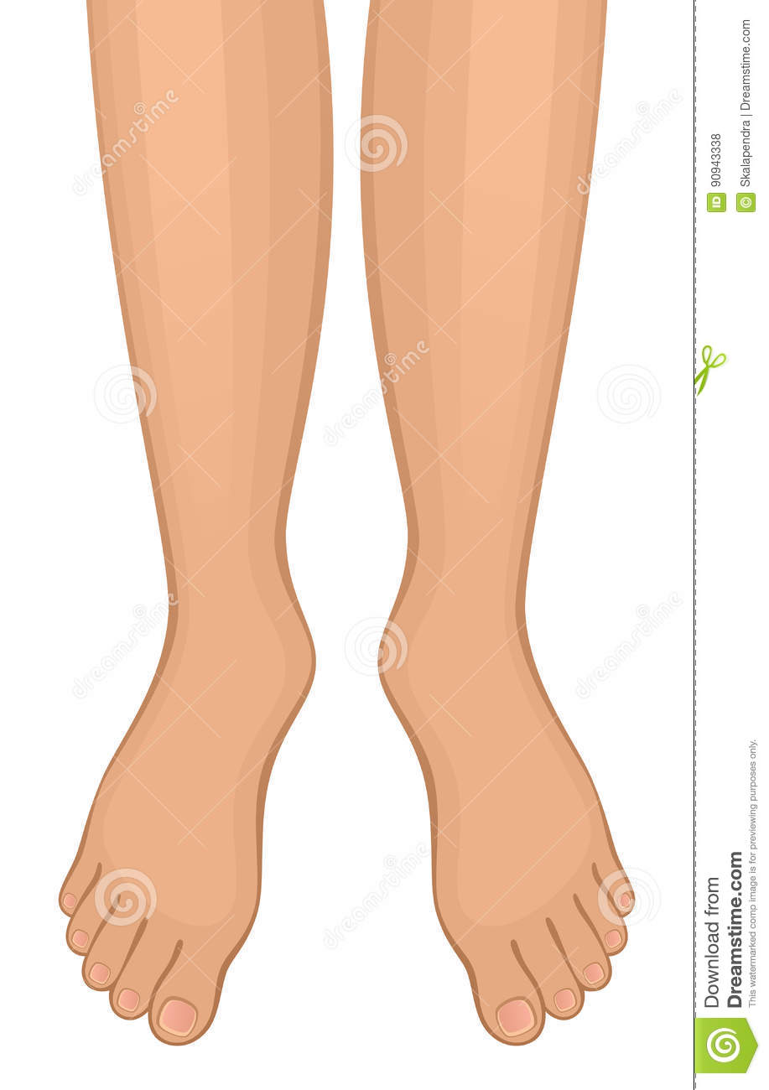

Slide 7
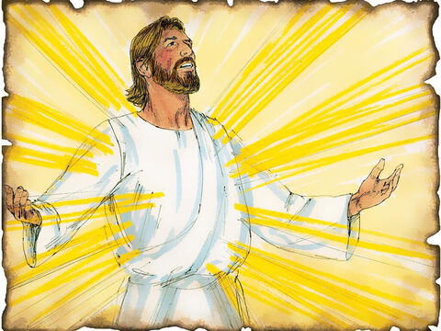

Slide 8
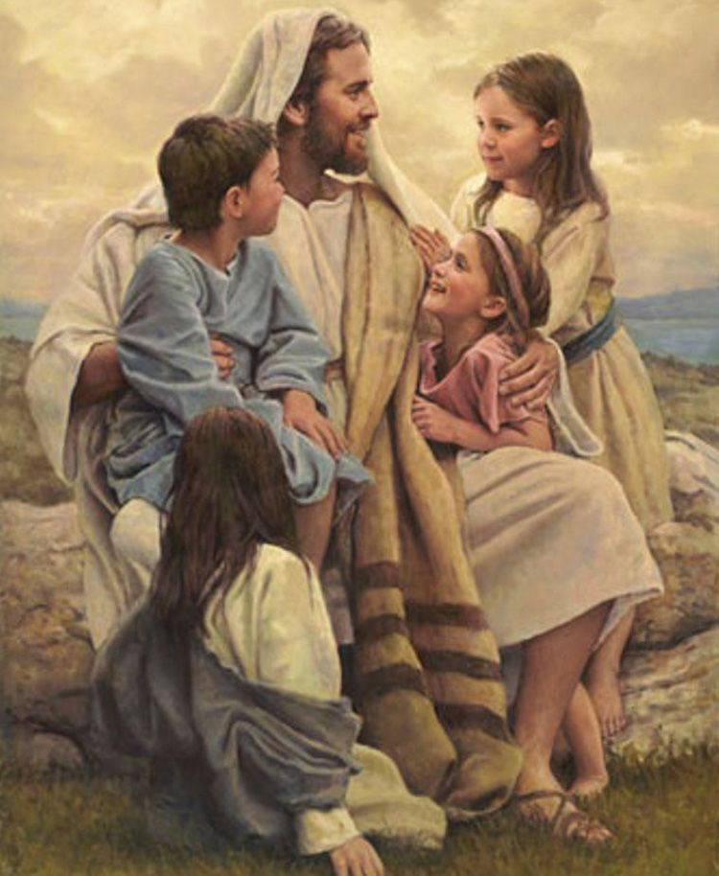

Slide 9
Zacchaeus
Notes:
Story about a sinner and what we can learn from it

Slide 10
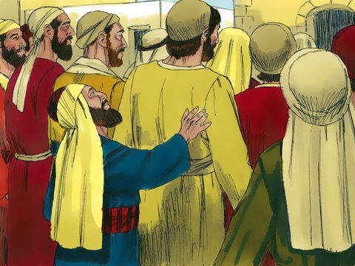

Slide 11
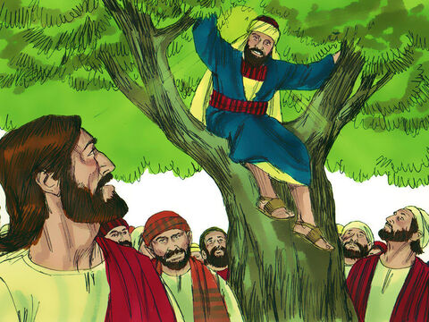

Slide 12
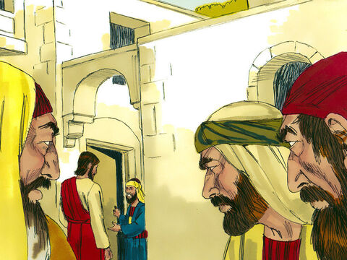

Slide 13
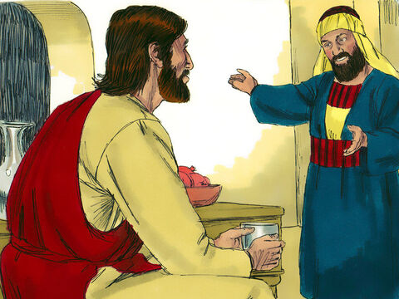

Slide 15
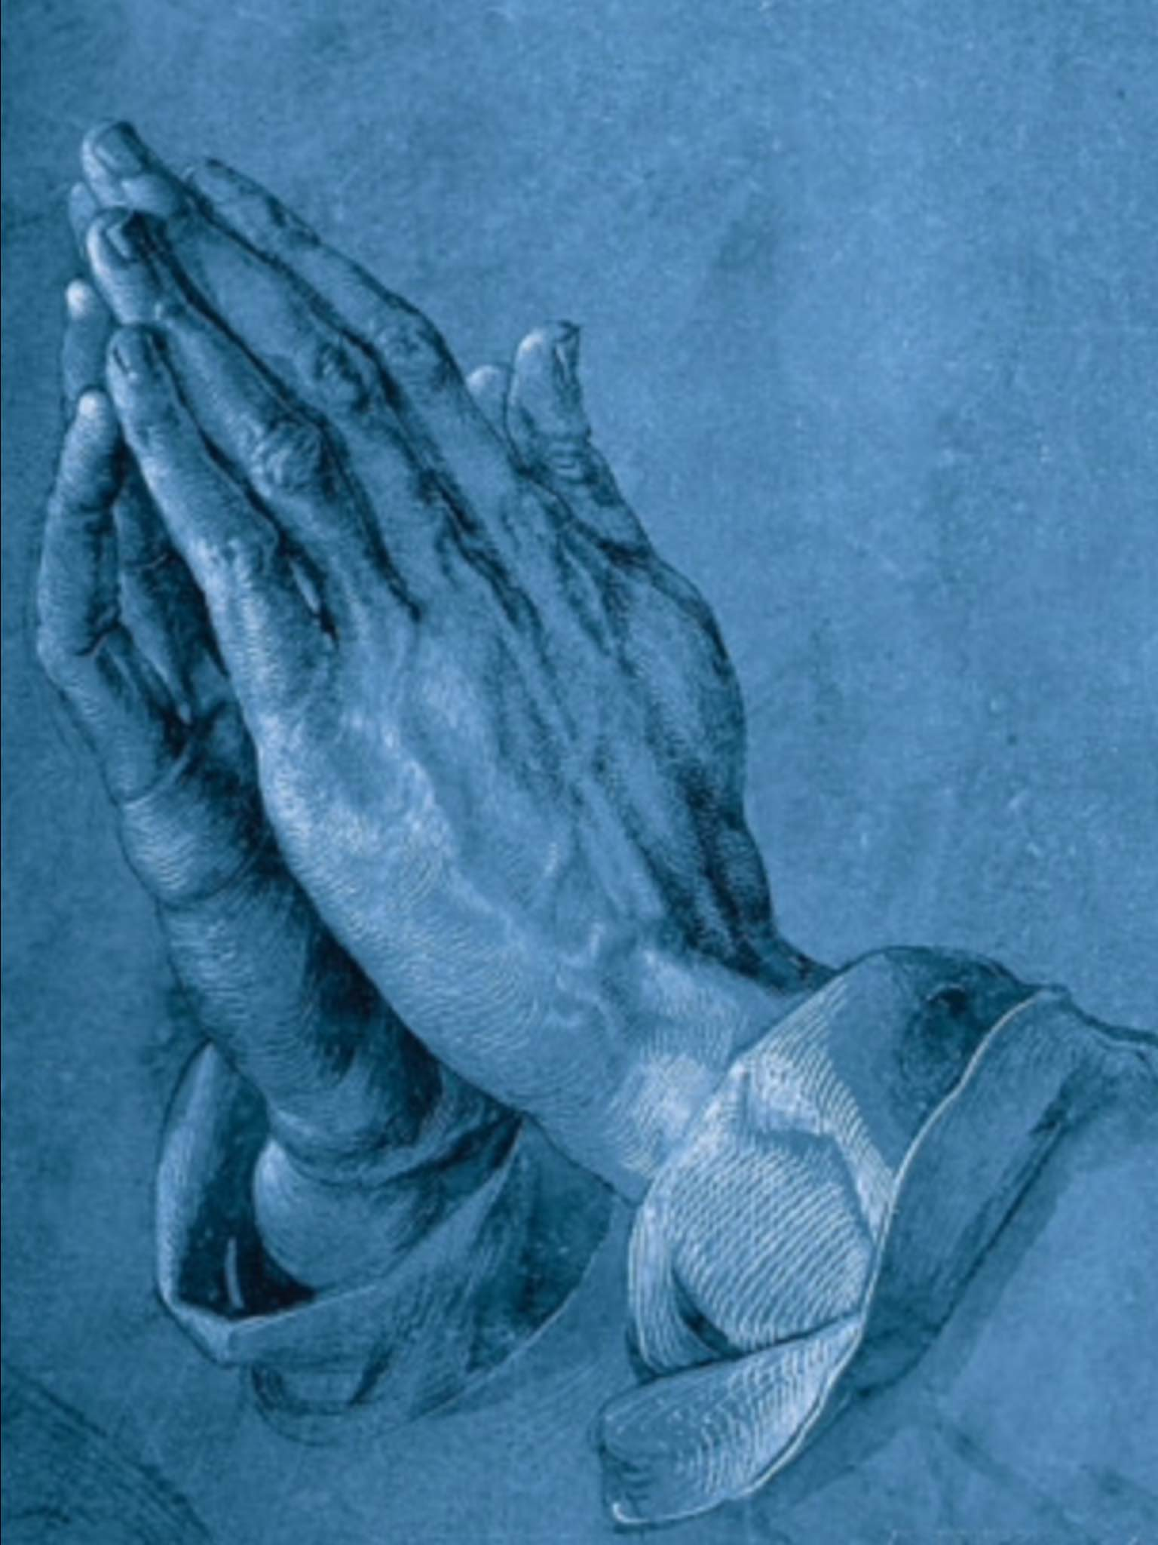
Notes:
Change of hearts shown in actions

Slide 16
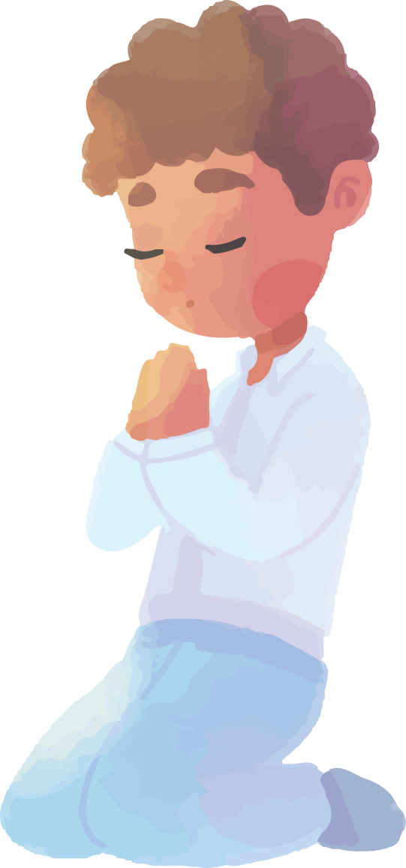
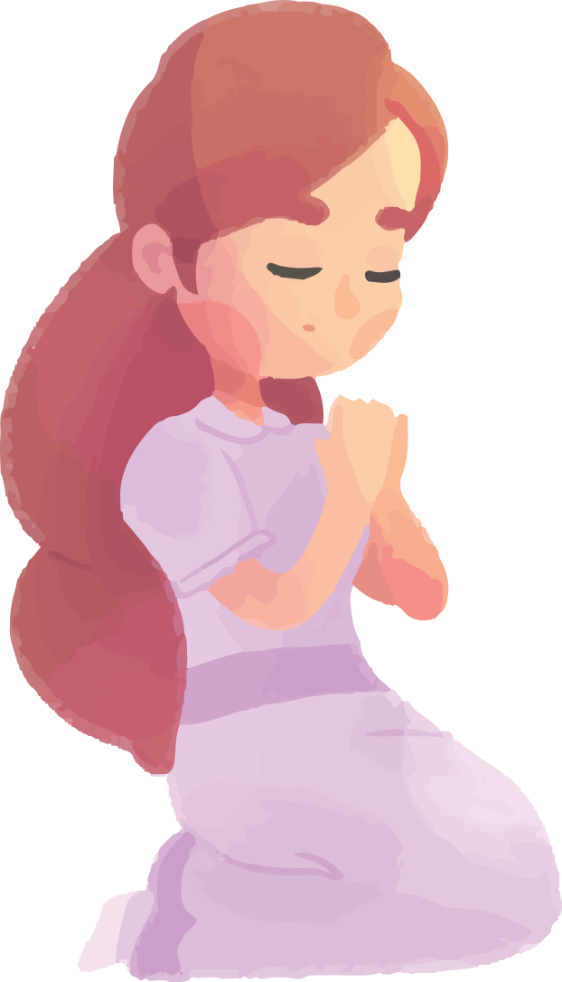
Bapa T’rima Kasih
Bapa t’rima kasih (2x)
Bapa di dalam surga
Puji t’rima kasih
Amin

Slide 17
Happy
Sunday!

